Slide 1
NutriSnap Accessible Nutrition for All
Jason Mahabir and Mike Lupton

Slide 2
Target Population
Impoverished communities
Those without access to proper nutrition and health services
“Poverty leads to financial constraints that in turn lead to the consumption of cheap, high-energy staple foods, primarily carbohydrates, and fats rather than nutritionally dense food.” – National Institutes of Health (NIH)
“High levels of stress, poor sleep, and cognitive overload compound the challenges of economic constraints, creating a mentality of scarcity that leads to poor diet quality.” – American Journal of Preventative Medicine

Slide 3
The Problem – Poor Nutrition in Impoverished Communities
Bridge the gap between low-income communities and proper nutrition services
NutriSnap seeks to provide low-income individuals with a new and accessible way to go about food shopping
Increase awareness for health and wellness
Help reduce ailments and illnesses associated with poor nutrition

Slide 4
Social Implications
Roughly 38 million (11.6%) of Americans live below the poverty line
30.7% of adults are overweight
NutriSnap – provides healthy eating options and alternatives to help combat poor nutrition associated with impoverishment
Creating a healthier America
Eating healthy should not just be for those that can afford it
Nutritional literacy
Cost-effective shopping for heathy alternatives
Reduce diet-related diseases

Slide 5
User Research
Design Ethnography
Gather data from low-income areas regarding consumer food spending habits
May have to gather data from a secondary source/study
Gain an understanding of the challenges faced by the user and what drives certain spending habits
Surveys
Gather a large amount of user data
Develop broad insights on community as a whole
Better able to see patterns

Slide 6
Design Solution/Challenges
Challenges
Finding the best companies within certain prices
Finding the most nutrional companies
Companies people like
Various Diets/Dietary Restrictions
Solutions
Simplicity
User based/Participatory design proces
Agile process with constant updates

Slide 7
Design Solution - Norman’s 7 Principles
Affordances-
Clear directions, buttons to show how to interact, scan items, and learn about companies
Constraints
Keep private data private
Feedback-
Heavily interaction based. Gives reccomendations based on info given from user
Consistency
Internally Consistent. Free flowing design that gives consistent pages/simplicity
Mappings/Visibility
Clearly labeled buttons for flow through pages for information on products
Conceptual Model

Slide 8
Features
Rate and compare brands based on environmental sustainability, price, location, nutrition, and popularity
Gives general information on the brands
Scale for daily nutritional values
Calorie Tracker
Calorie Calculator – estimate calories with a picture
Built-in coupons and promotional offers
What’s Trending?
Community inspired dishes and popular ingredients

Slide 9
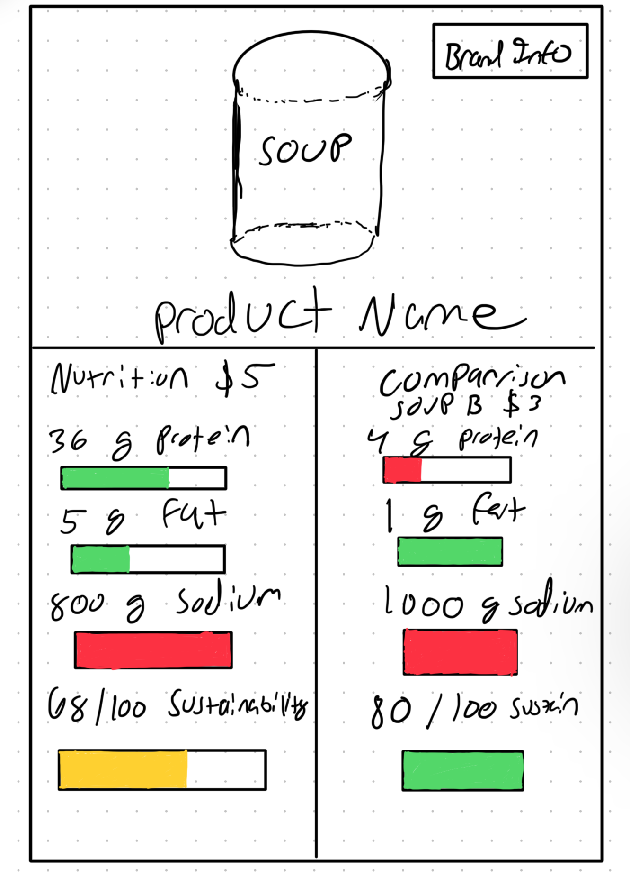
Sketches

Slide 10
Works Cited
https://pmc.ncbi.nlm.nih.gov/articles/PMC7485412/#:~:text=Poverty%20leads%20to%20financial%20constraints,but%20nutritional%20quality%20becomes%20compromised.
https://www.sciencedirect.com/science/article/pii/S0749379716303099
https://usafacts.org/articles/what-does-living-at-the-poverty-line-look-like/
https://www.niddk.nih.gov/health-information/health-statistics/overweight-obesity#:~:text=the%20above%20table-,Nearly%201%20in%203%20adults%20(30.7%25)%20are%20overweight.,obesity%20(including%20severe%20obesity).

